Slide 1


ABSENCE MANAGEMENT SETUP AND OPERATIONS
IN ORACLE ERP
1

Slide 2

OVERVIEW
01
02
03
Our Team
Introduction
Company Profile
04
05
Implementation Steps
Results & Benefits
2

Slide 3









OUR TEAM
Haidi Ali
Omar Essam
Nessma Saeed
Amal Morsi
Mohamed Ayman
Shery Mansour
3

Slide 4


INTRODUCTION
PROJECT OVERVIEW
Objective:
Guide users through configuring and managing absence types, leave
policies, employee leave requests, and reporting in Oracle Absence Management.
Scope:
Covers defining absence types, configuring eligibility criteria, setting ..... . up leave accruals, configuring approvals, managing balances, and
.... generating reports.
Expected Outcomes:
Operational absence management system with real-time tracking,
. compliance, and automated workflows.
4

Slide 5

COMPANY PROFILE:
MAAFCO MISR
Industry: Electromechanical Works
About: Maafco Misr is a prominent electromechanical contracting company based in Cairo, Egypt. Since its inception in 1994, the company has been dedicated to delivering high-quality electromechanical services across various sectors.
Employee Expertise:
Maafco Misr boasts a diverse team of
professionals, including engineers, technicians, and support staff, specializing in various fields
5

Slide 6

CHALLENGES & SOLUTIONS COVERED:
Challenges That Led to the Use of Oracle E-Business Suite (EBS) for Absence Management
01
Manual and Inefficient Leave Management → Automates & Streamlines Absence Management
02
Complex Leave Policies & Regulations → Ensures Policy Compliance & Reduces Errors
03
Lack of Integration with Payroll & HR Systems. → Integrates Seamlessly with Payroll & HRMS
04
Lack of Visibility & Reporting → Provides Real-Time Reporting & Insights
Oracle EBS Absence Management solves critical HR challenges,
making leave management efficient, compliant, and hassle-free.
6

Slide 7
IMPLEMENTATION STEPS:
Step 1: Defining Absence Types and Eligibility Criteria
Step 2: Setting Up Absence Plans for Leave Accruals
Step 3: Configuring Approval Workflows
Step 4: Managing Employee Leave Balances & Approvals
Step 5: Generating Reports using Oracle BI
Step 6: Auditing for Compliance and Accuracy
7

Slide 8


ABSENCE TYPE AND POLICY CONFIGURATION
Define Absence Types
Create Absence Plans
Configure Absence Eligibility
Set Up Approval Workflow
8

Slide 9
ABSENCE TYPE AND POLICY CONFIGURATION:
DEFINE ABSENCE TYPES
An Absence Type in Oracle defines the category and nature of leave employees can request.
It controls how absences are recorded, displayed, and processed in the system.
Absence Type | Description | Unit
Annual Leave | Paid time off for holidays. 21 per year. Increases to 30 days after 10 years of service or age above 50. | Days
Sick Leave | Paid leave due to illness or medical needs. Extended if needed; total of 180 days per year. First 90 days،75% of basic wage. Next 90 days،85% of basic wage. | Days
Maternity Leave | Paid leave for childbirth and postnatal recovery. Granted after 10 months of service, limited to twice during the full employment period. | Days
Study Leave | paid leave granted for exams or academic purposes. Must submit proof of exam participation. | Days
9

Slide 10
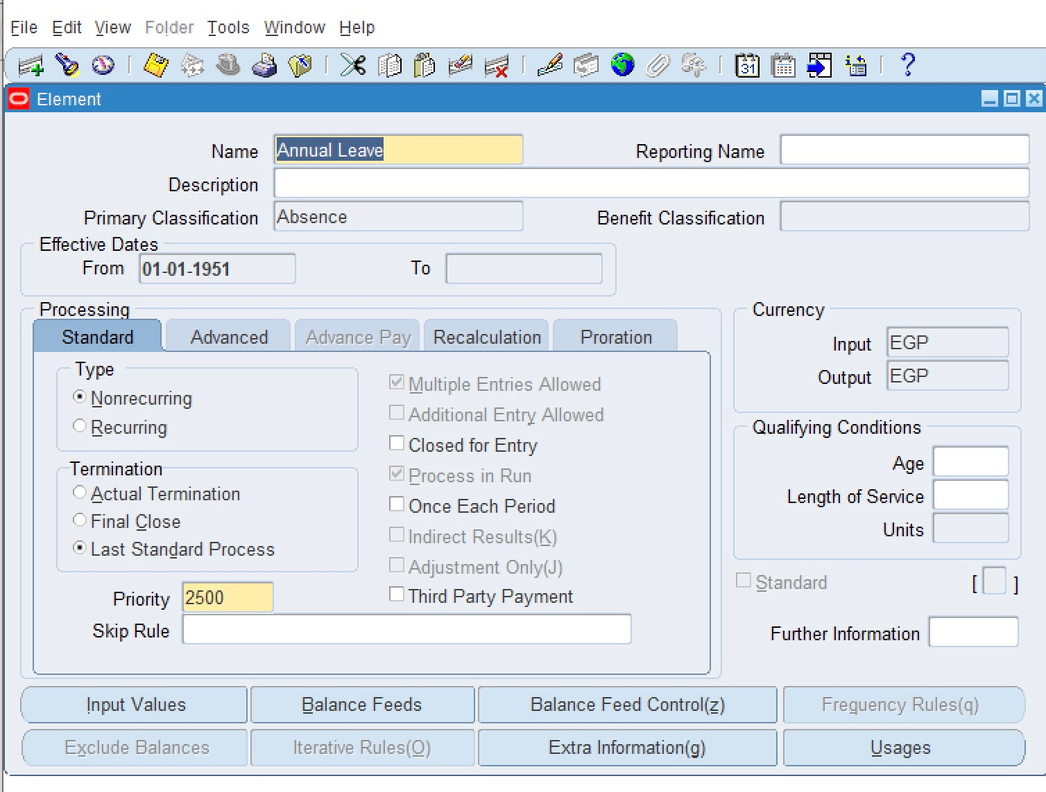
ABSENCE TYPE AND POLICY CONFIGURATION:
DEFINE ABSENCE TYPES
The first step to Create Absence Type is to create an element type :
Total Compensation → Basic → Element
10

Slide 11
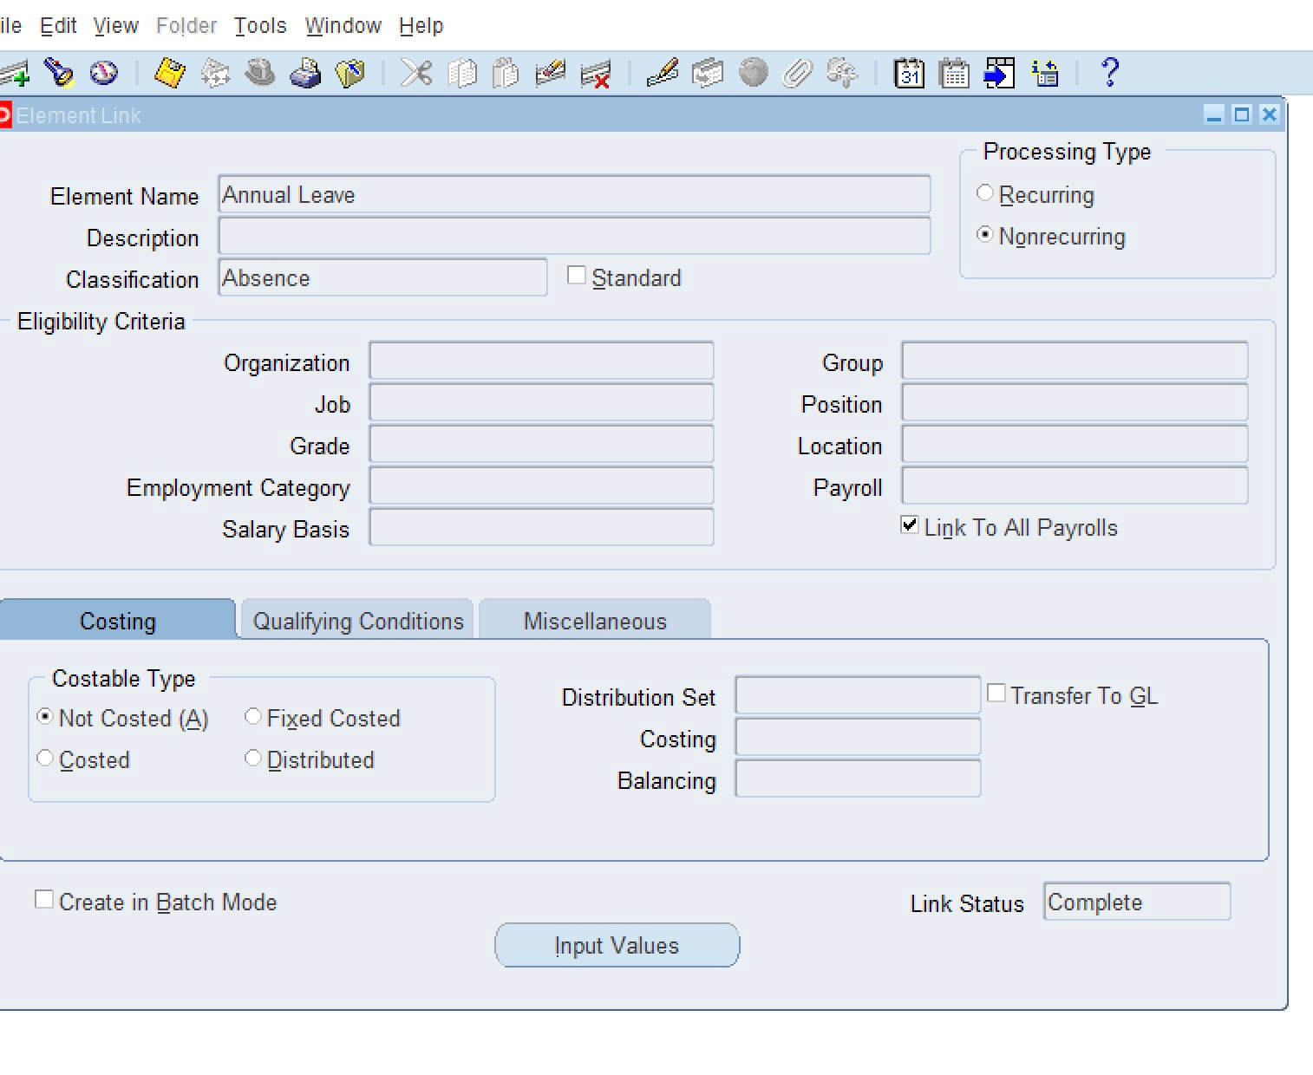
ABSENCE TYPE AND POLICY CONFIGURATION:
DEFINE ABSENCE TYPES
The second step is to link the element to restrict the type to certain jobs, or employee groups:
Total Compensation → Basic → Link
11

Slide 12
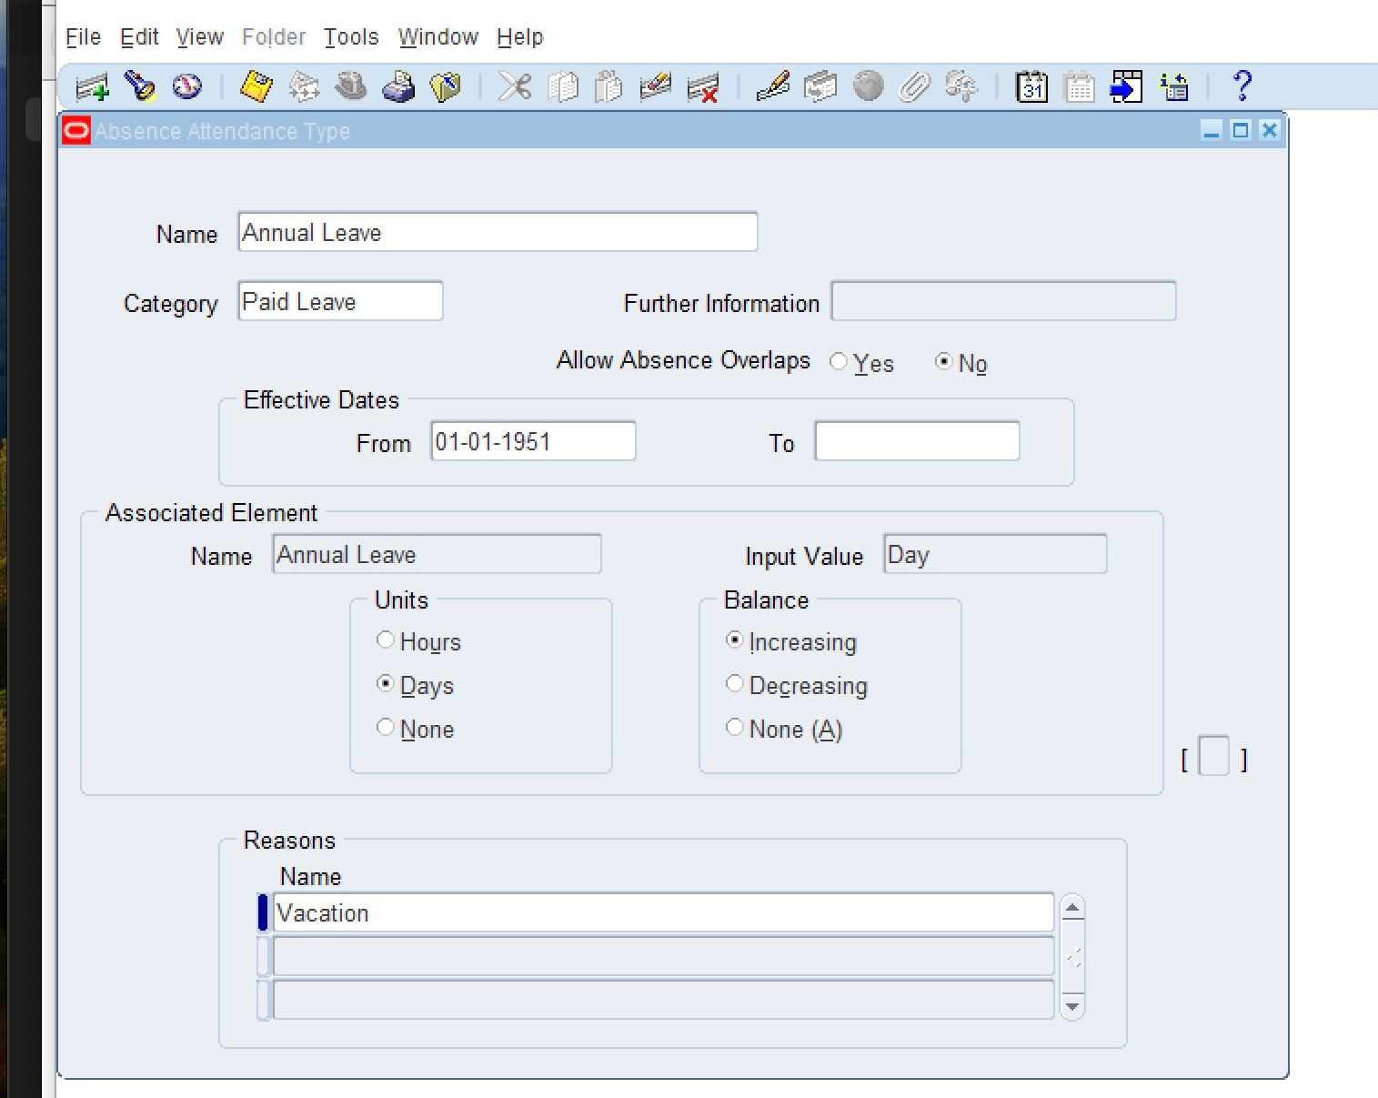
ABSENCE TYPE AND POLICY CONFIGURATION:
DEFINE ABSENCE TYPES
The Third and final step is to make an absence type and link it to the element (we can put reasons):
Total Compensation → Basic → Absence Types
12

Slide 13
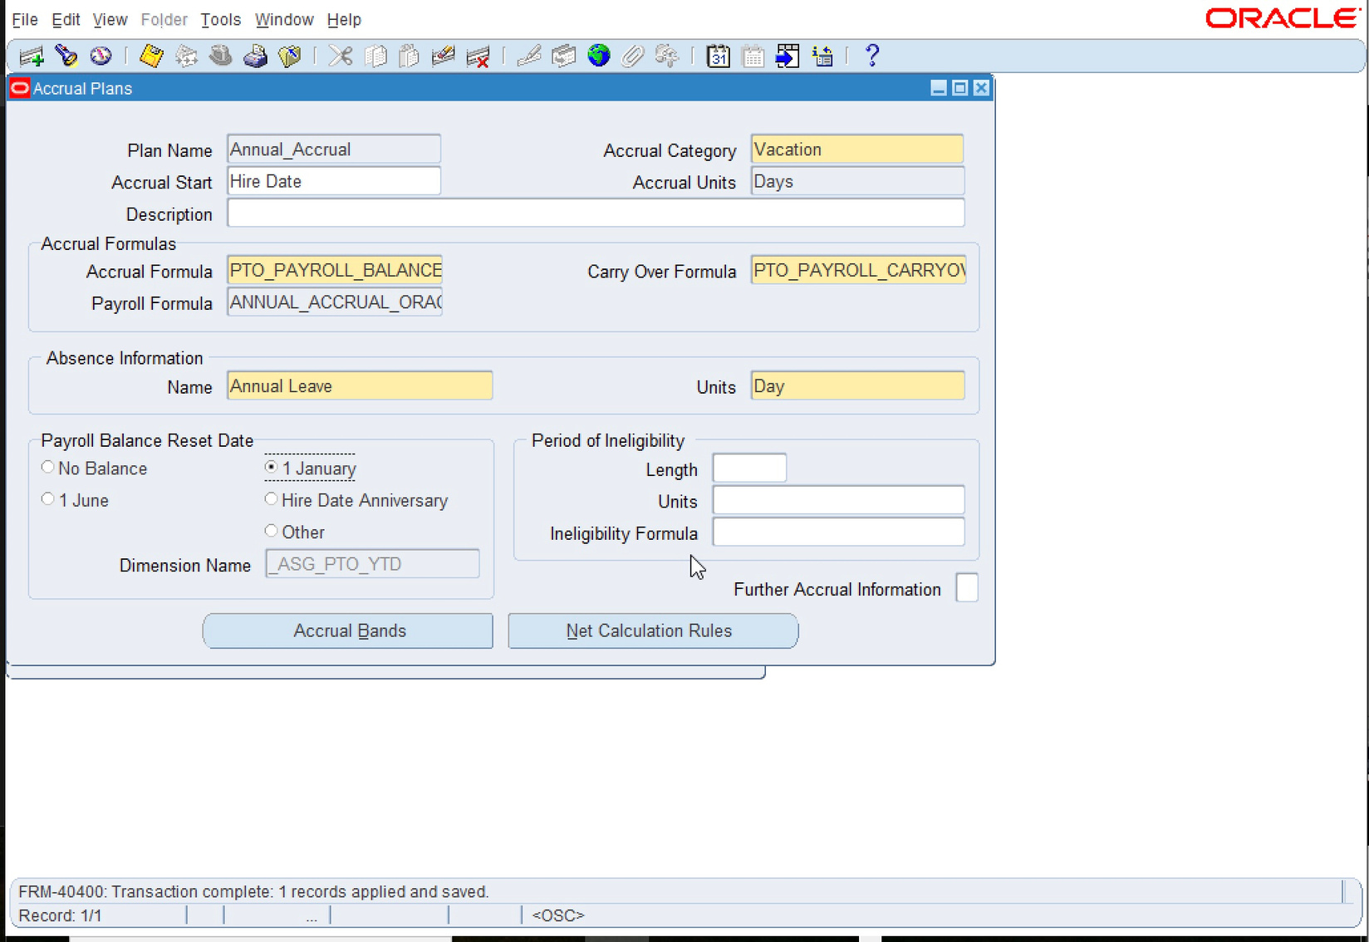
ABSENCE TYPE AND POLICY CONFIGURATION:
CREATE ABSENCE PLANS
Set up absence plans that define how leave is accrued and managed (e.g., vacation accrual, sick leave allocation).
Define leave entitlements and carryover rules.
Three steps to make an absence plan.
Here is the first step:
Total Compensation → Basic → Accrual Plans
1
13

Slide 14
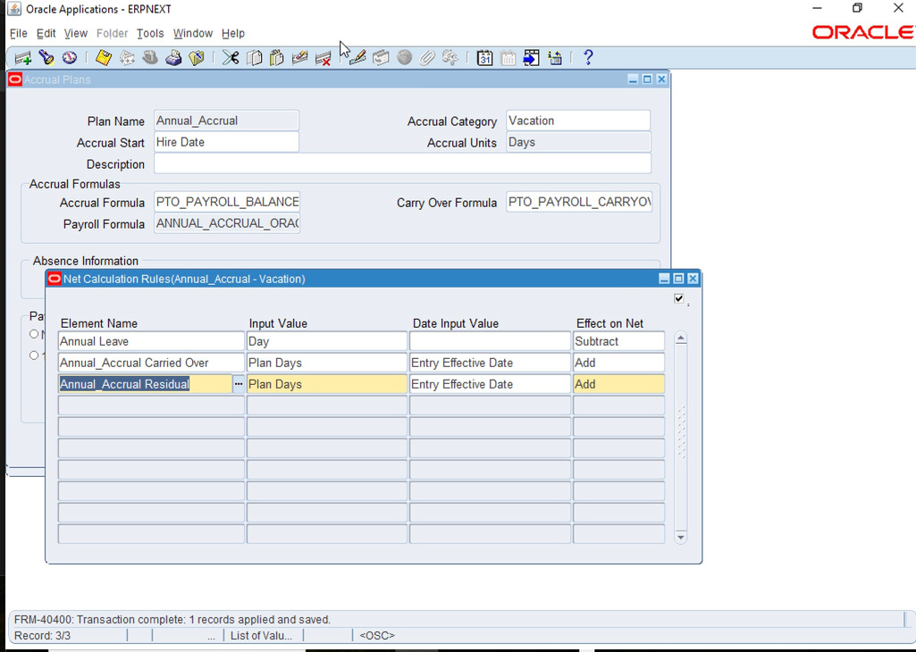
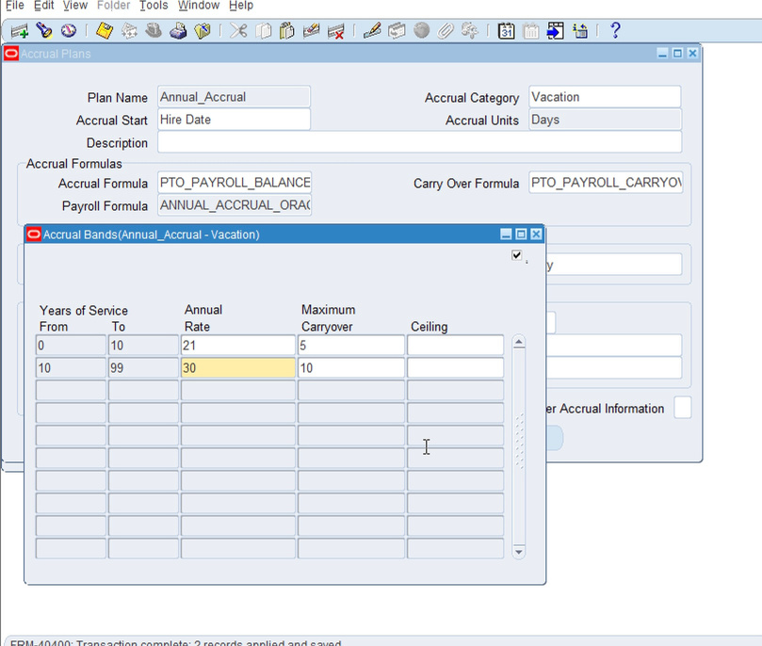
ABSENCE TYPE AND POLICY CONFIGURATION:
CREATE ABSENCE PLANS
2
the second step: elements associated with this plan
Total Compensation → Basic → Accrual Plans → Net Calculation Rules
3
the third step: Entitlement (30,21 days/year) and Carryover rules
Total Compensation → Basic → Accrual Plans →Accrual Bands
14

Slide 15
ABSENCE TYPE AND POLICY CONFIGURATION:
CONFIGURE ABSENCE ELIGIBILITY:
Employees are eligible based on attributes such as:
Job
Grade
Organization
Payroll
15

Slide 16
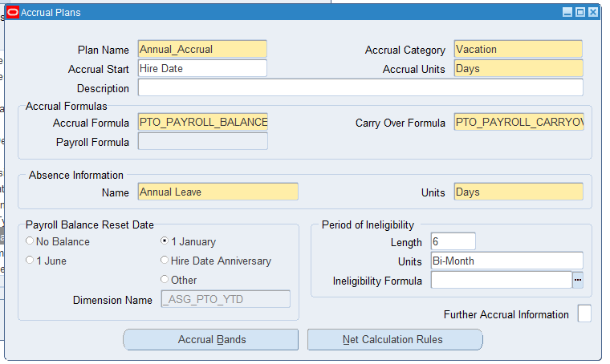
ABSENCE TYPE AND POLICY CONFIGURATION:
CONFIGURE ABSENCE ELIGIBILITY:
period of ineligibility
Total Compensation → Basic
→ Accrual Plans
EX:
Only full-time employees with more than 6 months of service are eligible for Annual Leave Plan.
16

Slide 17
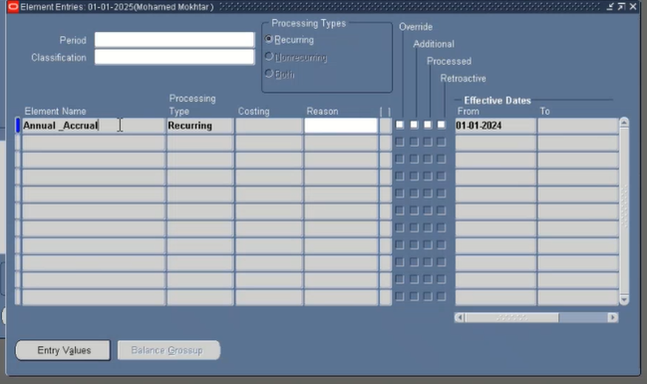
ABSENCE TYPE AND POLICY CONFIGURATION:
CONFIGURE ABSENCE ELIGIBILITY:
Assign absence plans to employees based on their role, tenure, and employment contract.
assigment → entries → adding accrual
plan element
17

Slide 18
ABSENCE TYPE AND POLICY CONFIGURATION:
SET UP APPROVAL WORKFLOW:
Employee submits leave request via self-service.
Request is routed to the manager or supervisor
for approval.
Upon approval, the absence is recorded in the system
and updated in the absence screen.
- Sick Leave — requires additional approval steps. In these cases, the request is not approved by the supervisor alone; it also needs HR review and approval before it appears in the Absence Management screen and need attachements.
18

Slide 19
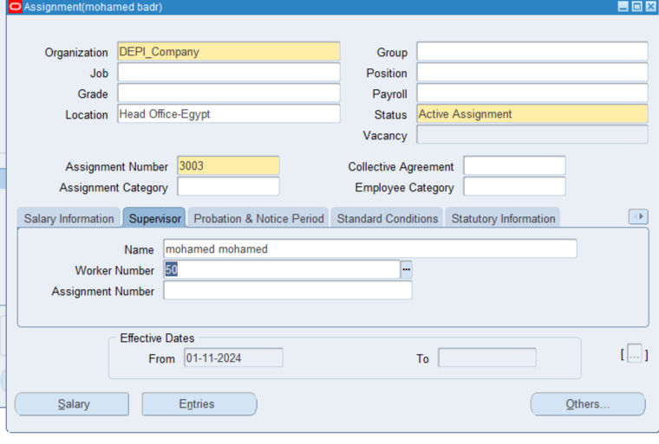
ABSENCE TYPE AND POLICY CONFIGURATION:
SET UP APPROVAL WORKFLOW
To set approval workflow:
First step:
assigment → supervisor
then fill the name and worker number.
19

Slide 20
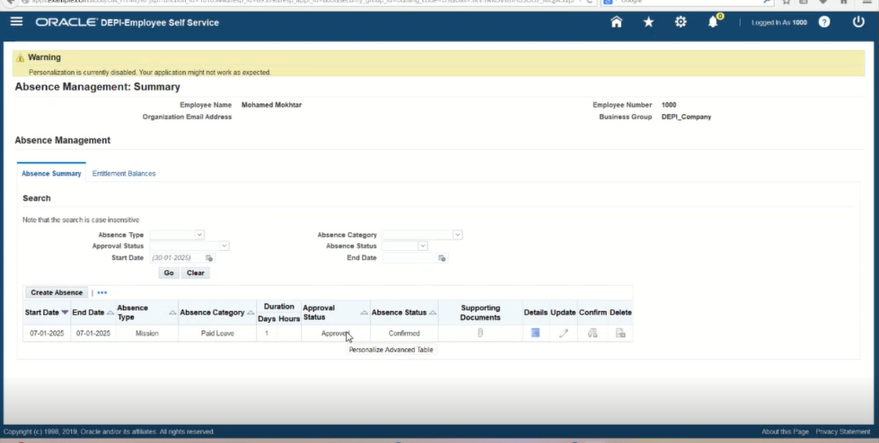
ABSENCE TYPE AND POLICY CONFIGURATION:
SET UP APPROVAL WORKFLOW
The employee logs into Employee Self‑Service and submits a request for the desired absence.
employee self service → absence mangement → create absence
20

Slide 21

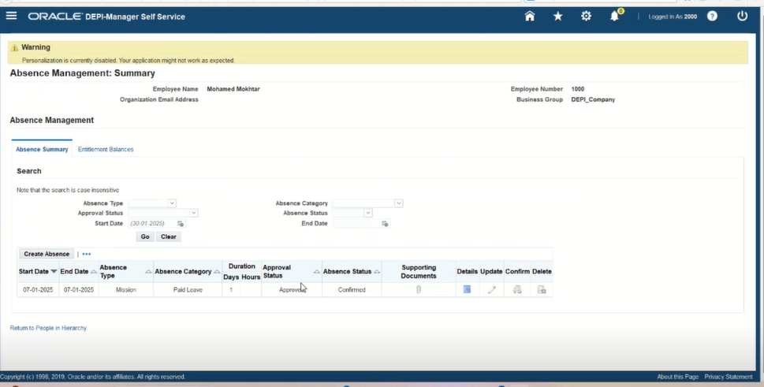
ABSENCE TYPE AND POLICY CONFIGURATION:
SET UP APPROVAL WORKFLOW
The manager approves or declines the absence request:
manager self service → all actions awaiting your attention
or
absence management → choose the employee from action button
Note: A manager can also create an absence for themselves in Absence Management by selecting their own name in the Action button.
21

Slide 22
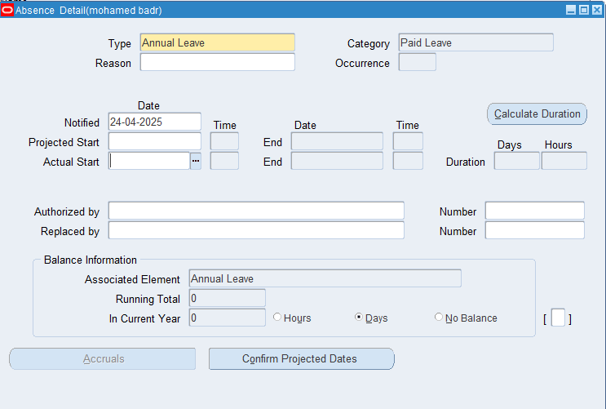
ABSENCE TYPE AND POLICY CONFIGURATION:
SET UP APPROVAL WORKFLOW
HR can manually create an absence request in an employee’s profile by completing the details on the Absence Details page.
22

Slide 23
ABSENCE REPORTING AND PERIOD-END PROCESSING
Generate Absence Reports
Absence Reconciliation
Manage Year-End Absence Processing
Audit Absence Data
23

Slide 24

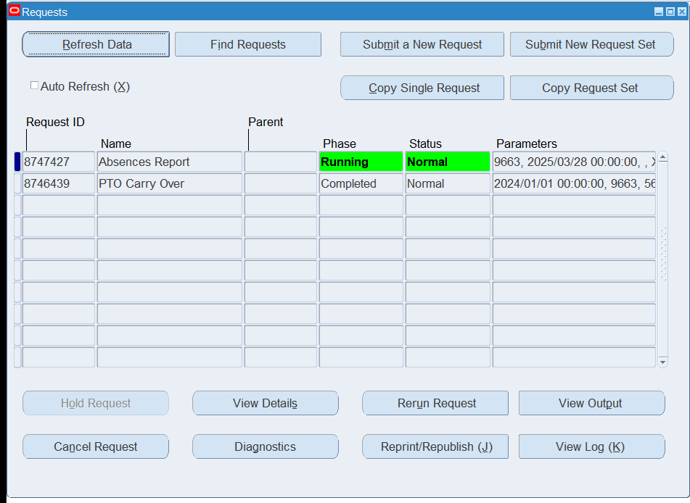
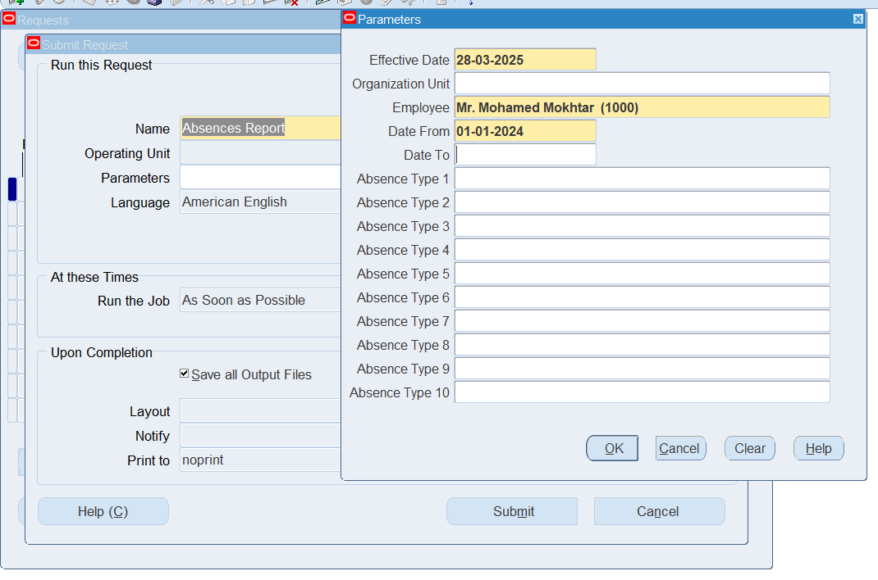
GENERATE ABSENCE REPORTS:
Go to requests page to request a report of ‘Absences Report’
View → Requests → Submit a new request
24

Slide 25
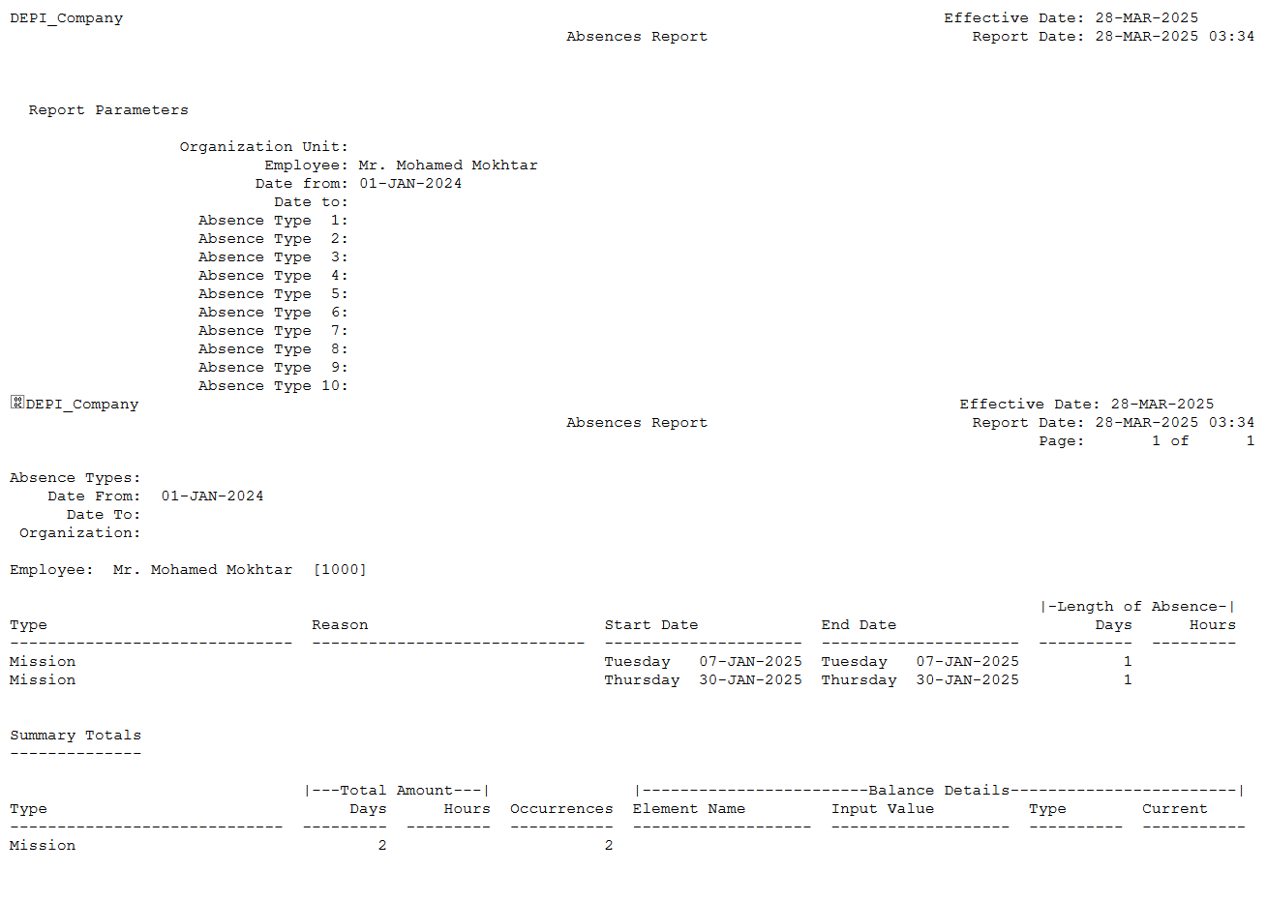
GENERATE ABSENCE REPORT
25

Slide 26
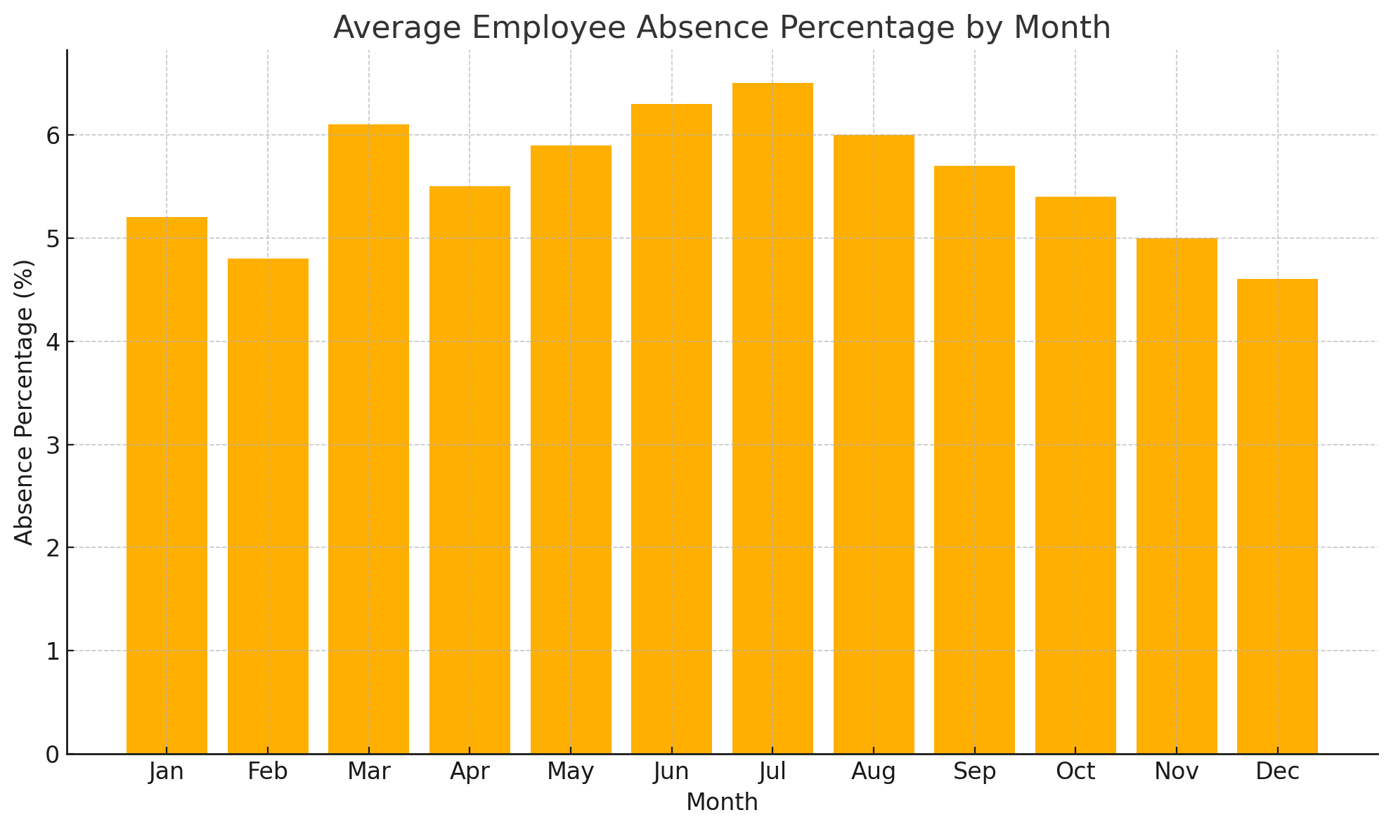
26

Slide 27
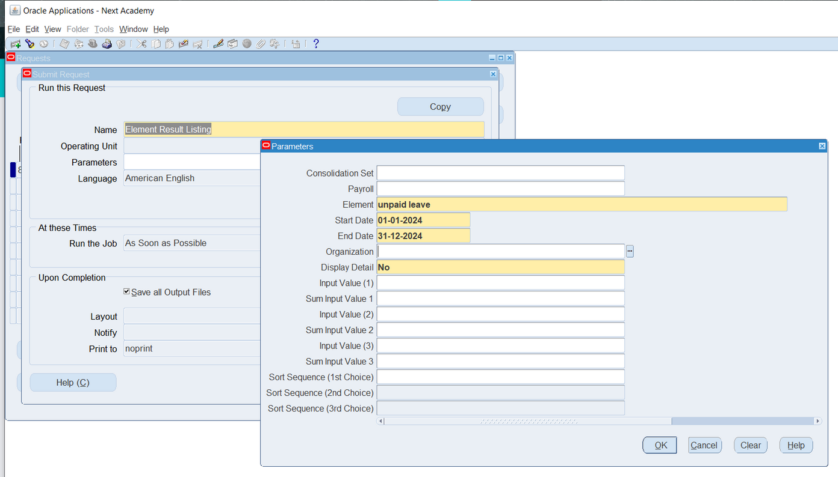
GENERATE RECONCILIATION REPORT
Go to requests page to request a report of ‘Reconciliation Report’
View → Requests → Submit a new request
27

Slide 28
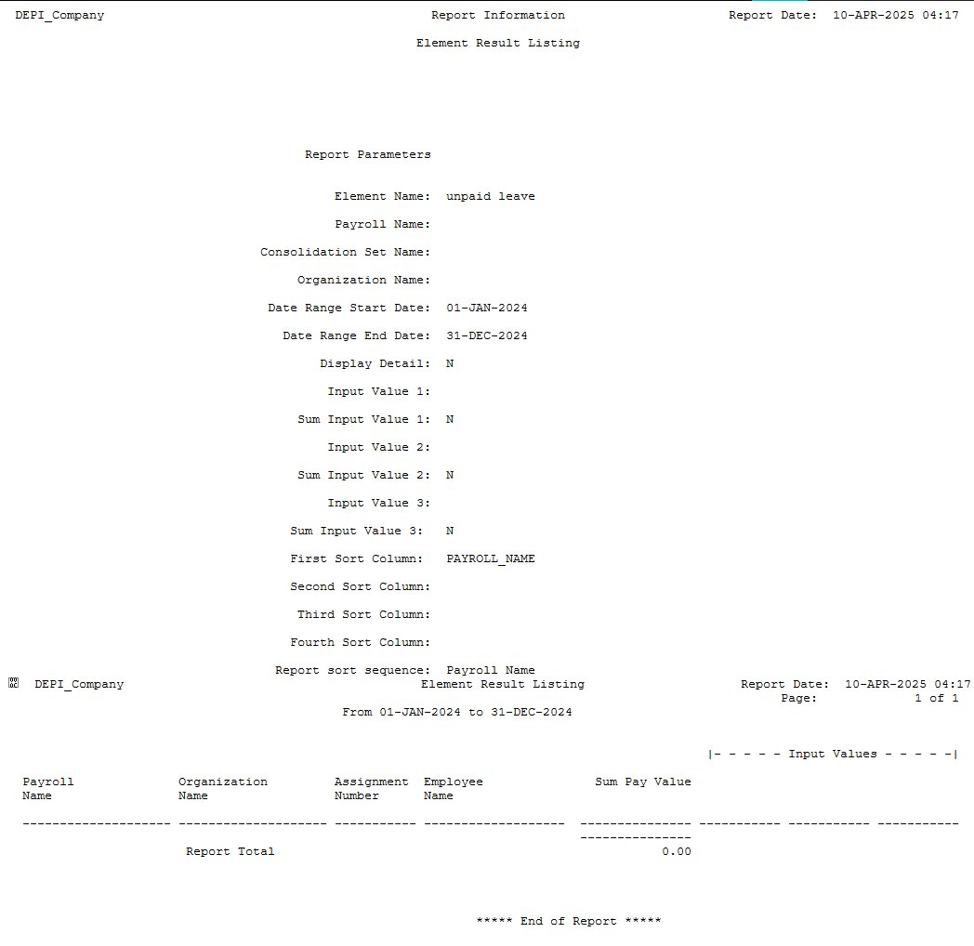
GENERATE RECONCILIATION REPORT
28

Slide 29
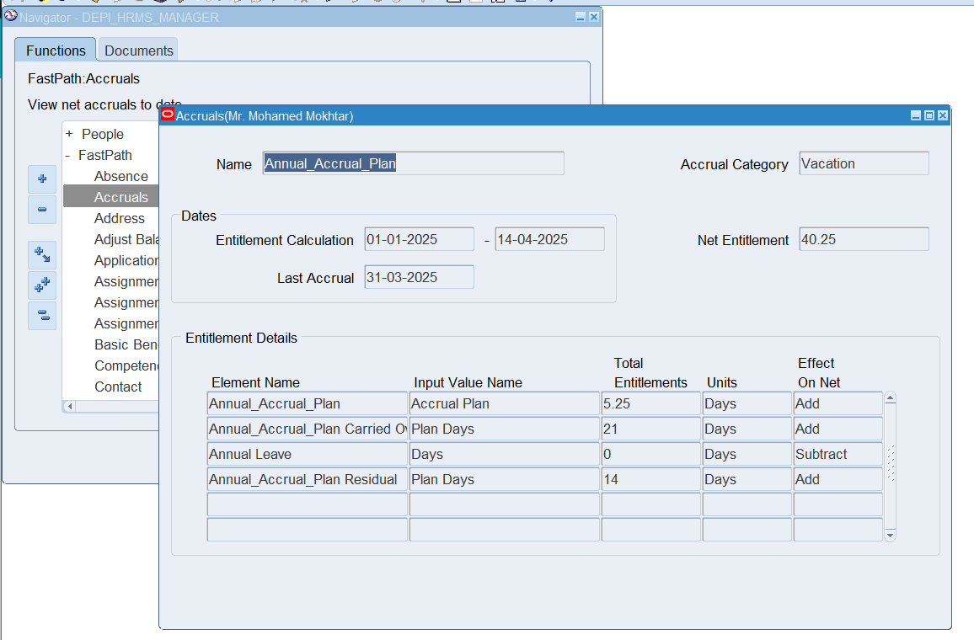
REVIEW LEAVE ACCRUALS AND ENTITLEMENTS TO ENSURE ACCURACY.
29

Slide 30

Manage Year-End Absence Processing
Goal: Absence period closed, and leave entitlements reset.
1
Close the absence period by ensuring that carryover leave balances
2
Resetting leave entitlements in the new year.
30

Slide 31
MANAGE YEAR-END ABSENCE PROCESSING:
CARRYOVER POLICY
CARRYOVER POLICY:
| Carryover Rule | Max Carryover |
Maximum of 5 to 10 days per year.
Carryover Expiration:
At the end of the first 3 months of the year
Expire (March 31)
21 Days | 5 Days
30 Days | 10 Days
31

Slide 32
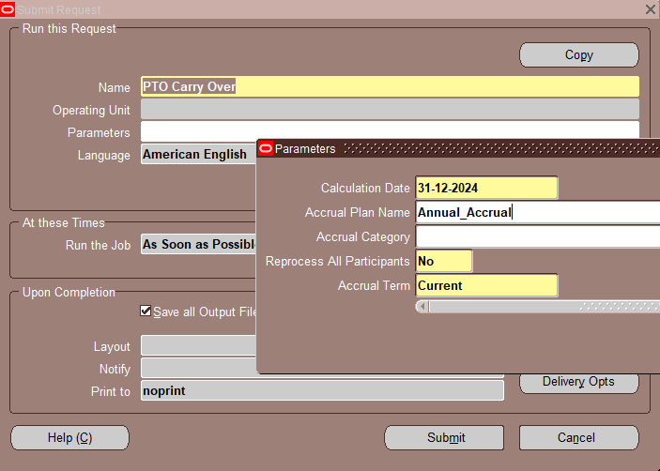
MANAGE YEAR-END ABSENCE PROCESSING:
RESET DATE: “ JANUARY 1 "
HOW TO CARRYOVER THE ABSENCE DAYS?
Using a Request from :
View → Request → Submit A New Request
Run the Request “ PTO CARRY OVER “
Choose the Parameters
32
Notes:
The Reprocess All Participants field defaults to No, so that the process affects only those plan participants not previously processed for this accrual term. To process all participants regardless of any previous processing, select Yes in this field.
Important: Select Yes if any employees have retrospective absences or other entries that might affect net entitlement.

Slide 33
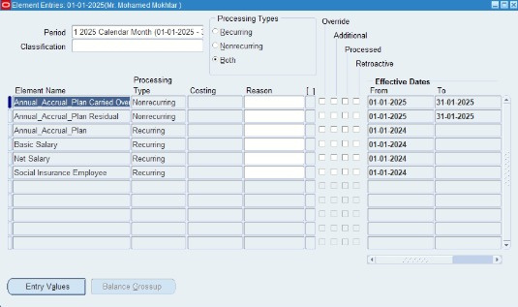
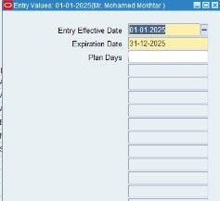
MANAGE YEAR-END ABSENCE PROCESSING:
CARRYOVER VALIDATION
THE EMPLOYEE HAD 10 DAYS LEFT SO HIS NEW BALANCE IS 5
“MAX DAYS”
33
Notes:
Carryover Validation
find the element
at date 1/1/25

Slide 34
MANAGE YEAR-END ABSENCE PROCESSING:
RESET LEAVE ENTITLEMENTS
LEAVE ENTITLEMENTS:
CARRY OVER ELEMENT
The employee balance was 5 days in 1/1/25
It expires by , March 31
So at 1/4/25 the balance is 0
0
34

Slide 35
Audit Absence Data
Goal: Internal audit of absence data completed for compliance.
1
Conduct an internal audit of absence data
Ensure compliance with labor laws
and organizational policies.
2
3
Address any discrepancies or missing leave data
35

Slide 36
AUDIT ABSENCE DATA:
CONDUCT AN INTERNAL AUDIT
POLICY OVERVIEW:
Leave Compensation Policy Based on Age
In accordance with company regulations and employee welfare considerations, the annual leave compensation shall be determined based on the employee’s age as follows:
Employees aged over 50 years: Entitled to 30 days of paid annual leave.
Employees aged 50 years or younger: Entitled to 21 days of paid annual leave.
36

Slide 37
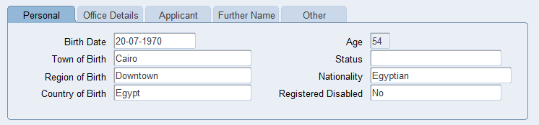
AUDIT ABSENCE DATA:
ADDRESS ANY DISCREPANCIES OR MISSING LEAVE DATA
DISCOVERED ISSUE:
During a routine review of employee records, it was identified that an employee over the age of 50 was incorrectly assigned only 21 days of paid leave instead of the entitled 30 days.
Leave Type | Accrual Plan | Entitlement (Days)
Annual Leave | Annual_Accrual Plan | 21
37

Slide 38


RESULTS OF USING ORACLE SYSTEM
Absence types, plans, and eligibility profiles configured. Approval workflow for leave requests set up.
Leave requests processed, approvals managed, leave balances tracked, and leave encashment configured.
Absence reports generated, absence data reconciled with payroll, absence period closed, and internal audit conducted.
38

Slide 39

THANK YOU
Special Thanks to our instructor who helped us throughout our journey
ENG/ Mohamed Mokhtar
39

